Slide 1
Bonus

Slide 2
Open 04-Import-Data.Rmd

Slide 3

(Applied) Data Science
Visualize
Import
Tidy
Model
Communicate
Transform
Program
CC BY-SA RStudio

Slide 4

Importing Data

Slide 5

readr
Simple, consistent functions for working with strings.
# install.packages("tidyverse")
library(tidyverse)
CC BY-SA RStudio

Slide 6
Compared to read.table and its derivatives, readr functions are:
~ 10 times faster
Return tibbles
Have more intuitive defaults. No row names, no strings as factors.
CC BY-SA RStudio

Slide 7
readr functions
function | reads
read_csv() | Comma separated values
read_csv2() | Semi-colon separated values
read_delim() | General delimited files
read_fwf() | Fixed width files
read_log() | Apache log files
read_table() | Space separated
read_tsv() | Tab delimited values
CC BY-SA RStudio

Slide 8
readr functions
function | reads
read_csv() | Comma separated values
read_csv2() | Semi-colon separated values
read_delim() | General delimited files
read_fwf() | Fixed width files
read_log() | Apache log files
read_table() | Space separated
read_tsv() | Tab delimited values
CC BY-SA RStudio

Slide 9
nimbus.csv
date,longitude,latitude,ozone
1985-10-01T00:00:00Z,-179.375,-87.5,.
1985-10-01T00:00:00Z,-178.125,-87.5,.
1985-10-01T00:00:00Z,-176.875,-87.5,.
1985-10-01T00:00:00Z,-175.625,-87.5,.
1985-10-01T00:00:00Z,-174.375,-87.5,.
1985-10-01T00:00:00Z,-173.125,-87.5,.
1985-10-01T00:00:00Z,-171.875,-87.5,.
1985-10-01T00:00:00Z,-170.625,-87.5,.
1985-10-01T00:00:00Z,-169.375,-87.5,.
CC BY-SA RStudio

Slide 10
nimbus.csv
date,longitude,latitude,ozone
1985-10-01T00:00:00Z,-179.375,-87.5,.
1985-10-01T00:00:00Z,-178.125,-87.5,.
1985-10-01T00:00:00Z,-176.875,-87.5,.
1985-10-01T00:00:00Z,-175.625,-87.5,.
1985-10-01T00:00:00Z,-174.375,-87.5,.
1985-10-01T00:00:00Z,-173.125,-87.5,.
1985-10-01T00:00:00Z,-171.875,-87.5,.
1985-10-01T00:00:00Z,-170.625,-87.5,.
1985-10-01T00:00:00Z,-169.375,-87.5,.
CC BY-SA RStudio

Slide 11
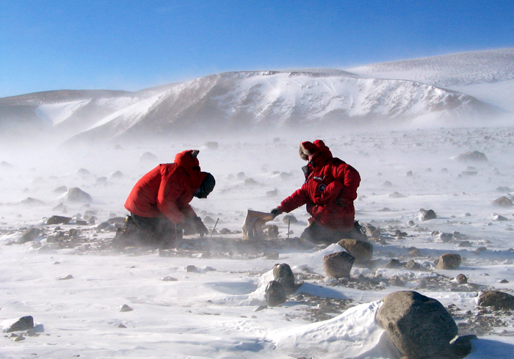
CC BY-SA RStudio

Slide 12
read_csv()
readr functions share a common syntax
df <- read_csv("path/to/file.csv", …)
object to save output into
path from working directory to file
CC BY-SA RStudio

Slide 13

Your Turn 1
Find nimbus.csv on your server or computer. Then read it into an object. Then view the results.

Slide 14
Your Turn 1
Find nimbus.csv on your server or computer. Then read it into an object. Then view the results.
nimbus <- read_csv("nimbus.csv")
nimbus

Slide 15
tibbles

Slide 16
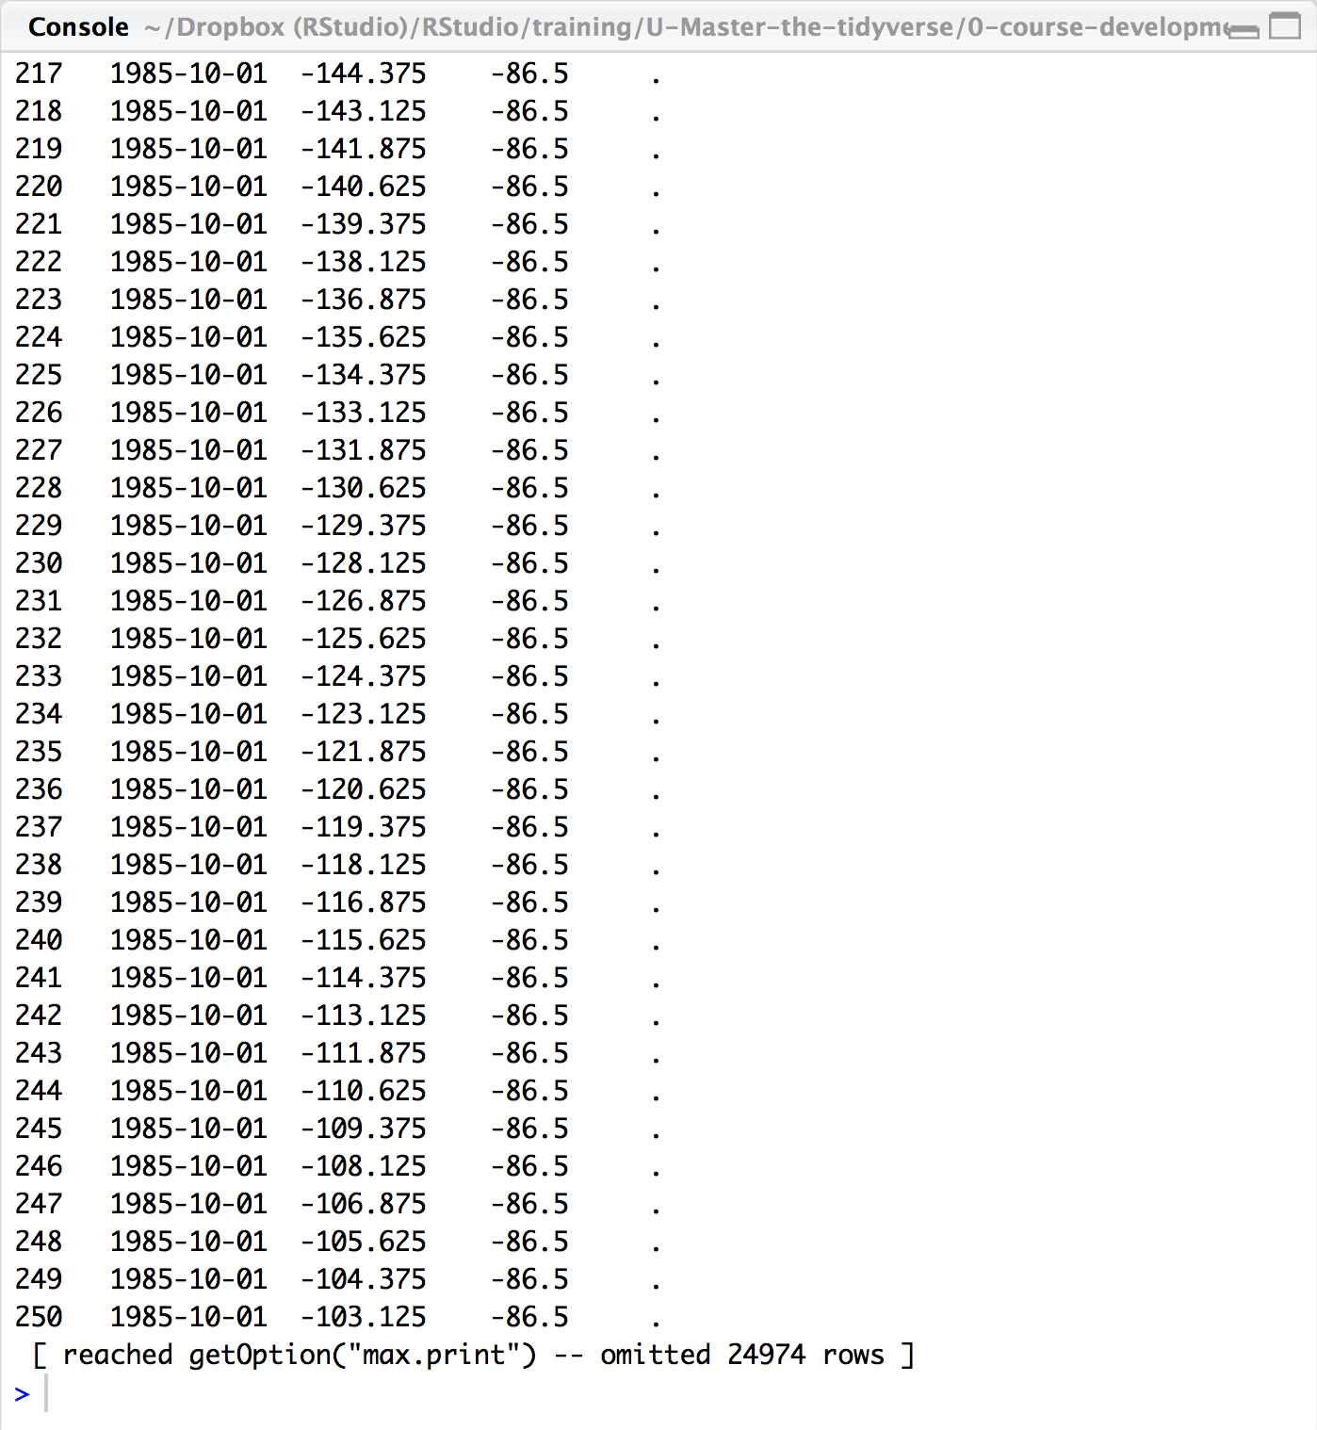
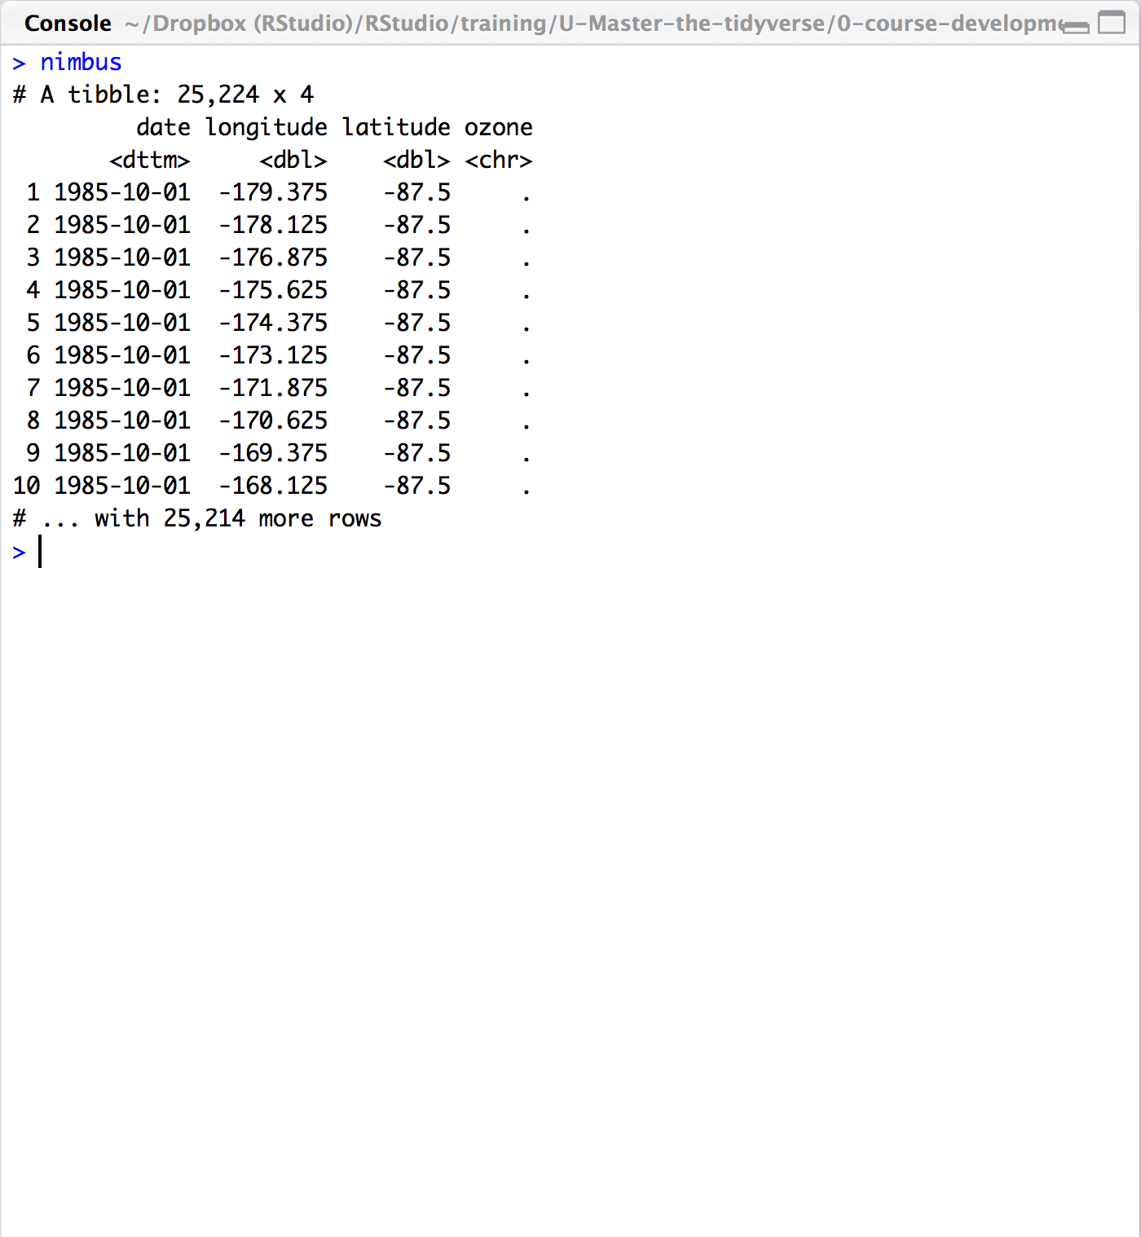
read.csv() vs. read_csv()
CC BY-SA RStudio

Slide 17
# A tibble: 234 × 6
manufacturer model displ
<chr> <chr> <dbl>
1 audi a4 1.8
2 audi a4 1.8
3 audi a4 2.0
4 audi a4 2.0
5 audi a4 2.8
6 audi a4 2.8
7 audi a4 3.1
8 audi a4 quattro 1.8
9 audi a4 quattro 1.8
10 audi a4 quattro 2.0
# ... with 224 more rows, and 3
# more variables: year <int>,
# cyl <int>, trans <chr>
wind | wind | wind
tibble display
156 1999 6 auto(l4)
157 1999 6 auto(l4)
158 2008 6 auto(l4)
159 2008 8 auto(s4)
160 1999 4 manual(m5)
161 1999 4 auto(l4)
162 2008 4 manual(m5)
163 2008 4 manual(m5)
164 2008 4 auto(l4)
165 2008 4 auto(l4)
166 1999 4 auto(l4)
[ reached getOption("max.print") -- omitted 68 rows ]
A large table to display
data frame display
CC BY-SA RStudio

Slide 18
tibbles
A type of data frame common throughout tidyverse packages. Tibbles enhance data frames in three ways:
Subsetting - [ always returns a new tibble, [[ and $ always return a new vector
No partial matching - You must use full column names when subsetting
Display - When you print a tibble, R provides a concise view of the data that fits on one screen
CC BY-SA RStudio

Slide 19
tibble
R package
A package with several helper functions for tibbles:
as_tibble() - convert a data frame to a tibble
as.data.frame() - convert a tibble to a data frame
tribble() - make a tibble (transversed)
tribble(
~x, ~y,
1, "a",
2, "b",
3, "c")
x | y
1 | a
2 | b
3 | c
CC BY-SA RStudio

Slide 20
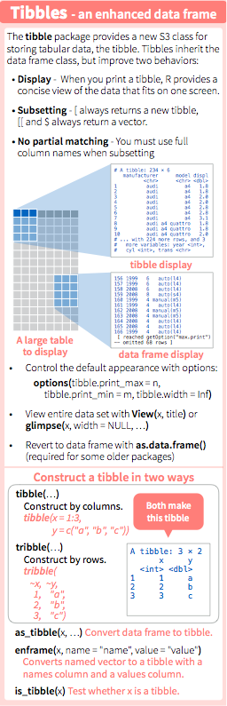
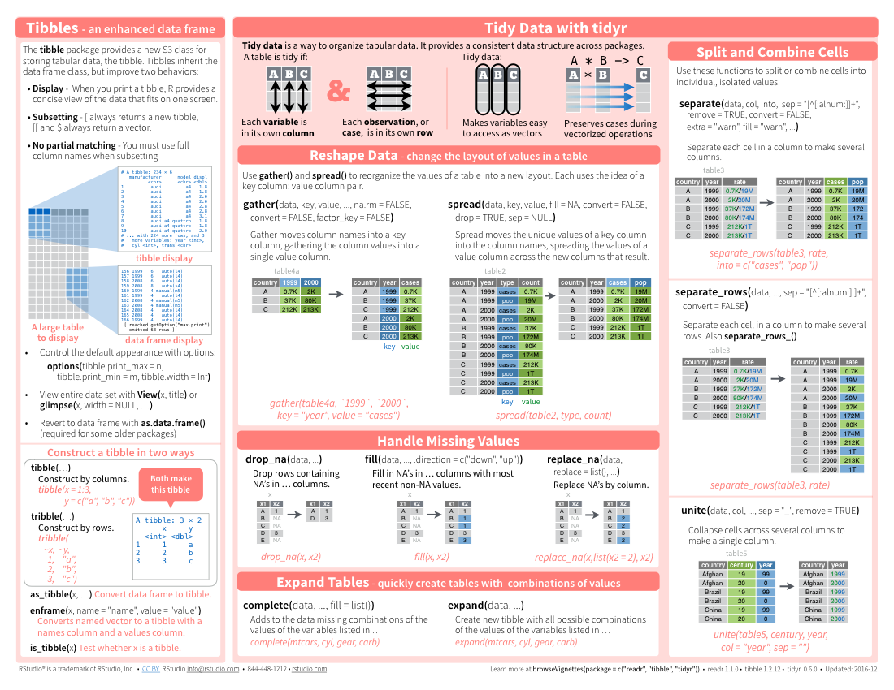
tibbles
CC BY-SA RStudio

Slide 21
Parsing

Slide 22
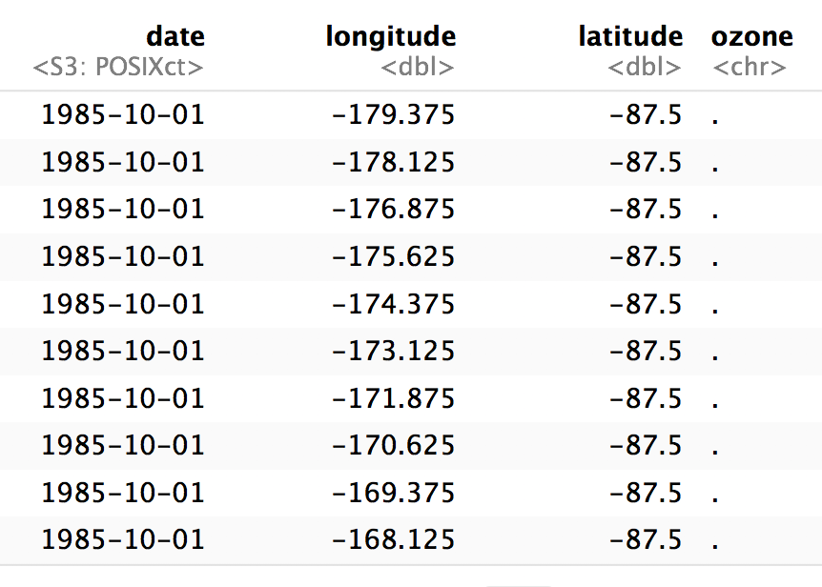
. = NA
nimbus
CC BY-SA RStudio

Slide 23
read_csv()
readr functions share a common syntax
nimbus <- read_csv("nimbus.csv", na = ".")
object to save output into
path from working directory to file
Value(s) to convert to NA
CC BY-SA RStudio

Slide 24
Your Turn
Reread in nimbus.csv. But this time convert the "."’s to NA’s. How many NA’s are in the ozone column?

Slide 25
Your Turn
Reread in nasa.csv. But this time convert the "."’s to NA’s. How many NA’s are in the ozone column?
nimbus <- read_csv("nimbus.csv", na = ".")
View(nimbus)
nasa %>%
summarize(nas = sum(is.na(ozone)), n = n())
## # A tibble: 1 × 2
## nas n
## <int> <int>
## 1 3092 25224

Slide 26
Quiz
What "type" of column is ozone?

Slide 27
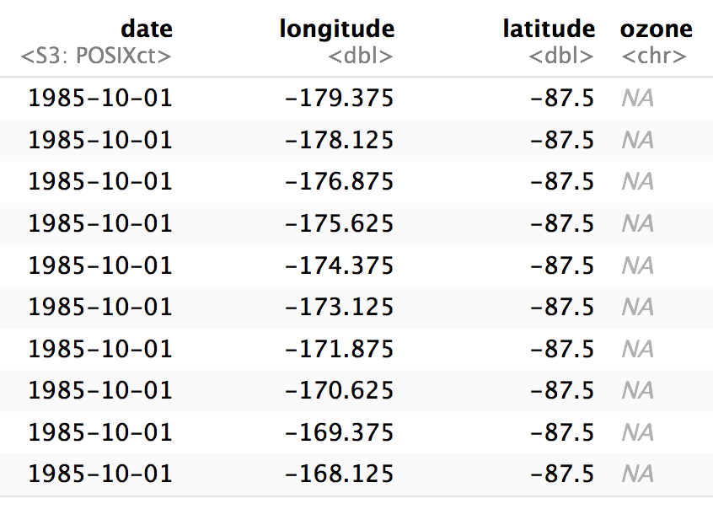
nimbus <- read_csv("nimbus.csv", na = ".")
<chr> stands for character string
(not a number)
CC BY-SA RStudio

Slide 28
read_csv()
readr functions share a common syntax
nimbus <- read_csv("nimbus.csv", na = "."),
col_types = list(ozone = col_double()))
Manually specify column types.
list
column name
Column type
function
CC BY-SA RStudio

Slide 29
type function | data type
col_character() | character
col_date() | Date
col_datetime() | POSIXct (date-time)
col_double() | double (numeric)
col_factor() | factor
col_guess() | let readr guess (default)
col_integer() | integer
col_logical() | logical
col_number() | numbers mixed with non-number characters
col_numeric() | double or integer
col_skip() | do not read
col_time() | time
CC BY-SA RStudio

Slide 30
type function | data type
col_character() | character
col_date() | Date
col_datetime() | POSIXct (date-time)
col_double() | double (numeric)
col_factor() | factor
col_guess() | let readr guess (default)
col_integer() | integer
col_logical() | logical
col_number() | numbers mixed with non-number characters
col_numeric() | double or integer
col_skip() | do not read
col_time() | time
CC BY-SA RStudio

Slide 31

Your Turn
Read in nimbus.csv. accounting for NA’s and setting the col_type of ozone to a double. Then make this plot. What do you see?
library(viridis)
world <- map_data(map = "world")
nimbus %>%
ggplot() +
geom_point(aes(longitude, latitude, color = ozone)) +
geom_path(aes(long, lat, group = group), data = world) +
coord_map("ortho", orientation=c(-90, 0, 0)) +
scale_color_viridis(option = "A")

Slide 32
nimbus <- read_csv("nimbus.csv", na = ".",
col_types = list(ozone = col_double()))
library(viridis)
world <- map_data(map = "world")
nimbus %>%
ggplot() +
geom_point(aes(longitude, latitude, color = ozone)) +
geom_path(aes(long, lat, group = group), data = world) +
coord_map("ortho", orientation=c(-90, 0, 0)) +
scale_color_viridis(option = "A")
CC BY-SA RStudio

Slide 33
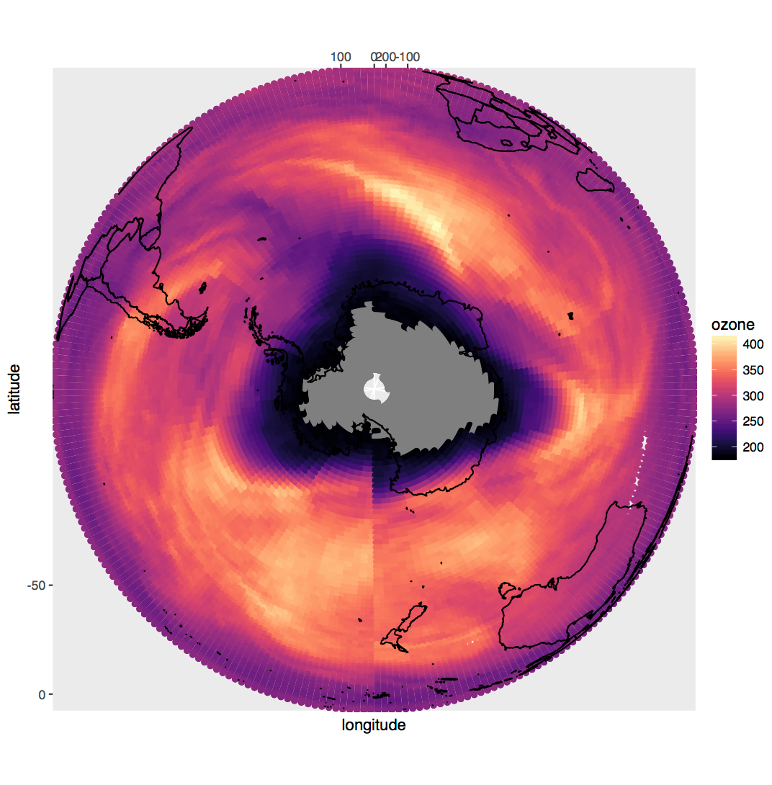
CC BY-SA RStudio

Slide 34
Writing

Slide 35
readr functions
function | writes
write_csv() | Comma separated values
write_excel_csv() | CSV intended for opening in Excel
write_delim() | General delimited files
write_file() | Single string, written as is
write_lines() | Vector of strings, one element per line
write_tsv() | Tab delimited values
CC BY-SA RStudio

Slide 36
write_csv()
Saves data set as a csv on your computer.
write_csv(nimbus, file = "nimbus2.csv")
Table to save
file
path to save at
CC BY-SA RStudio

Slide 37
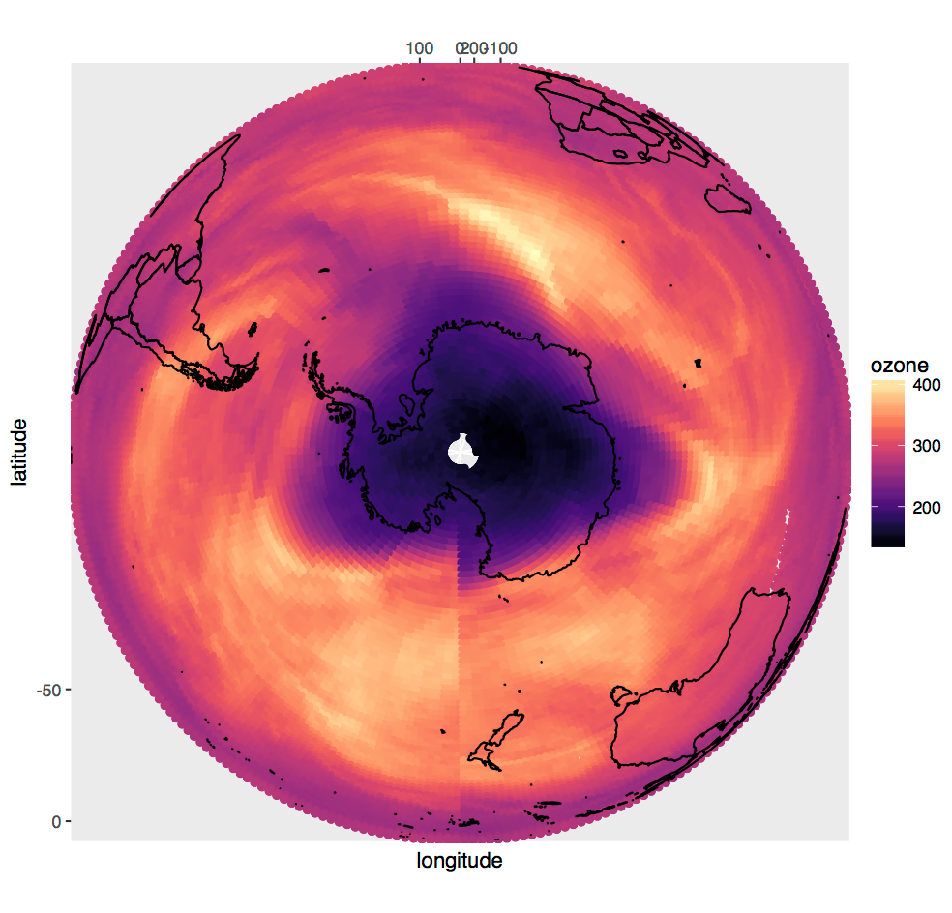
CC BY-SA RStudio

Slide 38
Other types of data
package | accesses
haven | SPSS, Stata, and SAS files
readxl | excel files (.xls, .xlsx)
jsonlite | json
xml2 | xml
httr | web API’s
rvest | web pages (web scraping)
DBI | databases
sparklyr | data loaded into spark
CC BY-SA RStudio

